Slide 1


Transport for South Midlands
An explainer – Harry Burr

Slide 2
Who I am

Slide 3
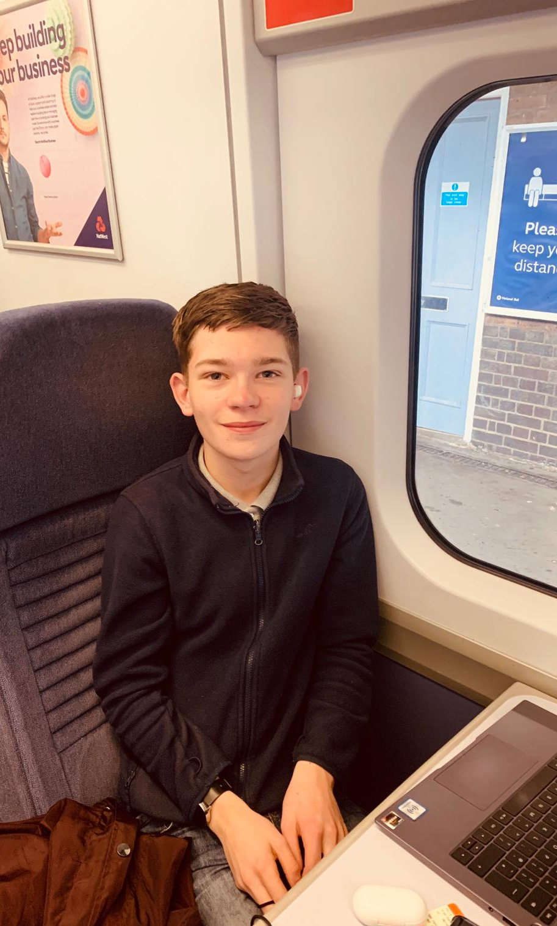
Hello!
I'm Harry Burr, a 14 year old railway campaigner based in Northampton.
I lived in Canterbury in Kent for around 9 years before moving to Northampton. As you may know, Kent has a plethora of railway stations (almost 100) compared to Northamptonshire's 6.
I am increasingly aware of the view that something has to be done about this; Northamptonshire is lagging behind the rest of the UK in rail travel.
During Lockdown 1.0 in March and April, I had a lot of extra time on my hands, and started researching the way the rail industry works, including franchising, the Beeching cuts, and railway lines in the UK.
With this extra knowledge, and time, I started two new projects, one being a new railway station for Daventry, and another being a new railway line for Northamptonshire.

Slide 4

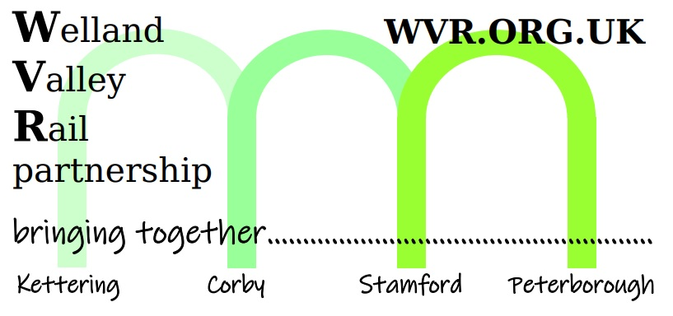














Hello!
During the development of my projects, and the first steps of campaigning, I would have never even dreamed of this much help from organizations, on a national, local, and regional level.
People from all areas of the UK have helped me along my way, and here are just a few of them, including massive multinationals, to local not-for-profit organizations.

Slide 5
My existing projects

Slide 6
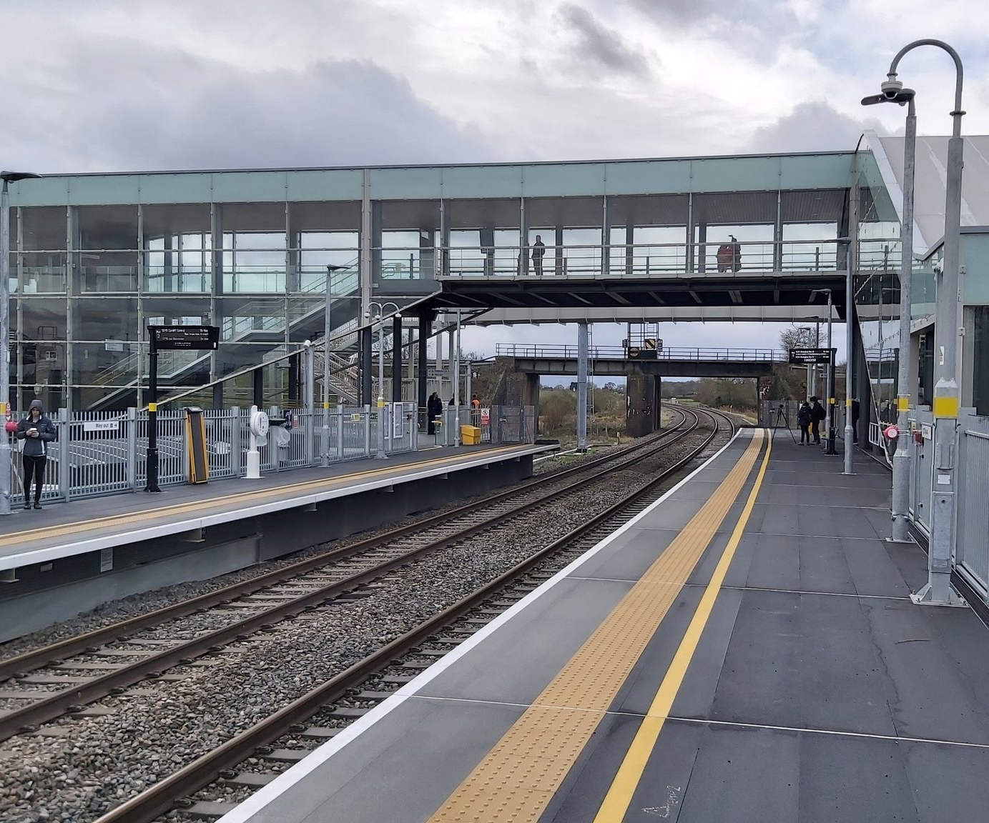
Weedon Station Project.
During Lockdown 1.0, I was shocked by how little Northamptonshire had in terms of rail travel, without a station on the West Coast Main Line in the entire county.
I wanted to change this, so I formed the Weedon Station Project, with a goal to reinstate the railway station in Weedon, acting as a Daventry Parkway station, serving one of the largest towns in the UK without a rail link (Daventry, of course), now at a 25,000 population, only set to increase.
The station in Weedon will be located just under an A45 road bridge, around a 5 minute drive and 20 minute bike ride from the Daventry high street.
A big target for this station is accessibility, especially via wheelchair, which Long Buckby currently has totally none of.
Although this station will act as a parkway station, we will be encouraging sustainable transport to get to and from the station. One of the ways we can do this is offering efficient bus connections to nearby towns
One of the more environmentally friendly ways of getting to and from the station is via bike, being only a 20 minute ride to the station from the town centre, and vice versa.
As well as this, more and more towns in Northamptonshire are getting e-scooter schemes, which could also happen in Daventry which could link in well with the new station. A new footpath and bikeway could also be built from Daventry to the new station, possibly.
EV chargers will be in place at the station, allowing a “charge and ride” system, if you like

Slide 7
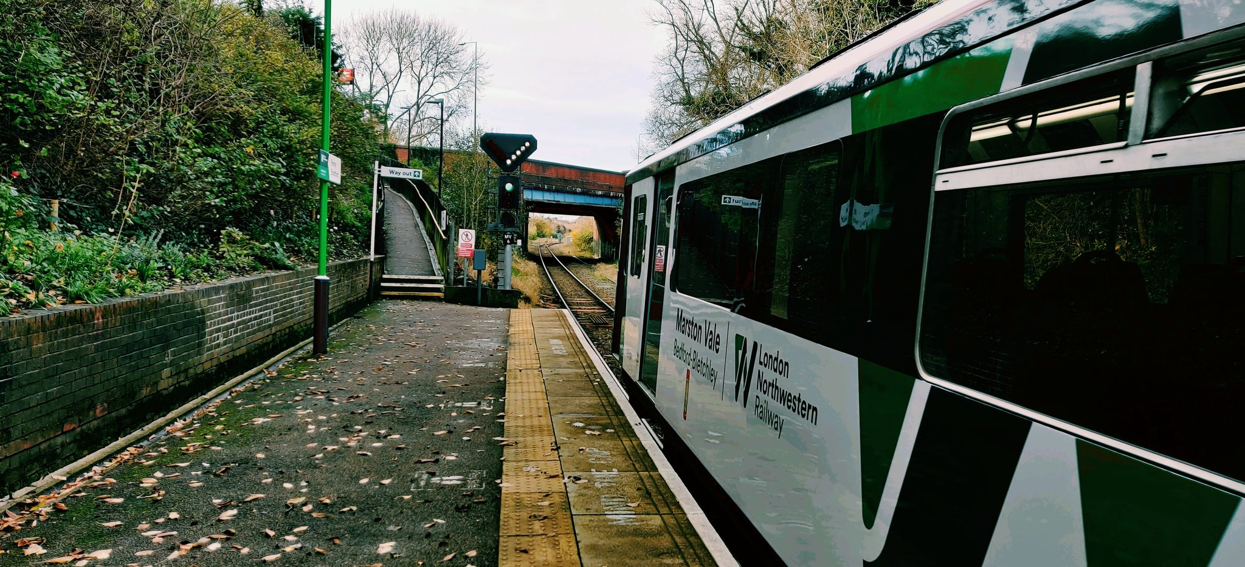
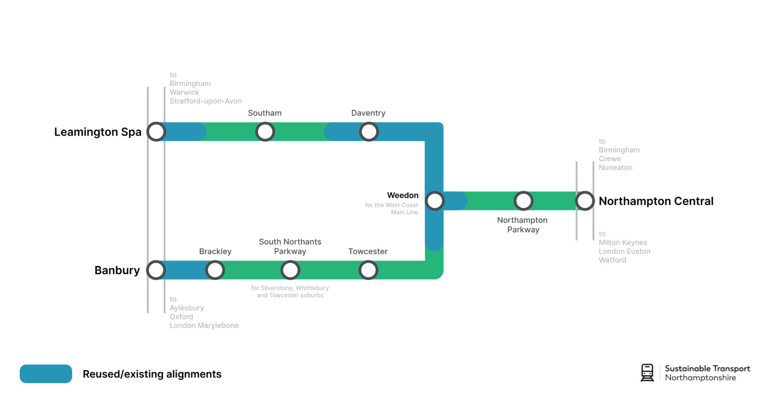
South Northants Link.
In August, just before I went back to education, I advanced my efforts to include an entirely new railway line serving Northampton, South Northants, Daventry, North Oxfordshire, Southam and Leamington Spa, which I have named South Northants Link, using old and new track formations.
The new line will serve towns such as Towcester, Brackley, and of course, Daventry, some of the largest towns in the country without a rail link.
The line will also connect the large town of Northampton to the towns of Banbury and Leamington Spa in Oxfordshire and Warwickshire respectively.
The new link is somewhat similar to the Marston Vale Line operating between Bedford and Bletchley in Milton Keynes.
Daventry is one of the largest towns in the UK (pop. 25,000) without a rail link.
The economy will receive a massive boost if the line gets the go ahead, allowing communities with bad public transport, especially Daventry, to get reconnected to the rail network.
Northamptonshire would no longer be known for bad rail links, and Northampton would receive it’s second station, finally.

Slide 8
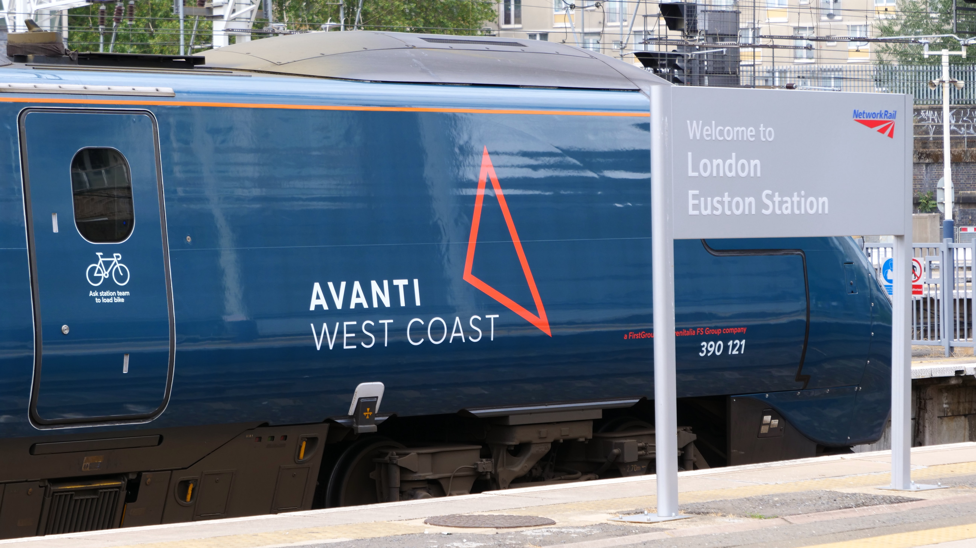
Sustainable Transport Northamptonshire
Earlier this year, I found out managing multiple projects under multiple umbrellas is hard, so I formed Sustainable Transport Northamptonshire to help me manage all these campaigns.
Sustainable Transport Northamptonshire saves me money, time and management hardships by allowing me to put everything under one name, one email address, one account etc.
We are currently operating as an unincorporated association, a type of organization that isn’t registered with the Government yet, however, we are a not-for-profit.

Slide 9
Transport for South Midlands

Slide 10
Who we are
Transport for South Midlands is a consortium of local councils and some stakeholders, such as Parish and town councils, District, County, and Unitary Authorities, and certain local businesses and sub-national transport bodies.
However, today, we are focussing on you, a parish council.

Slide 11
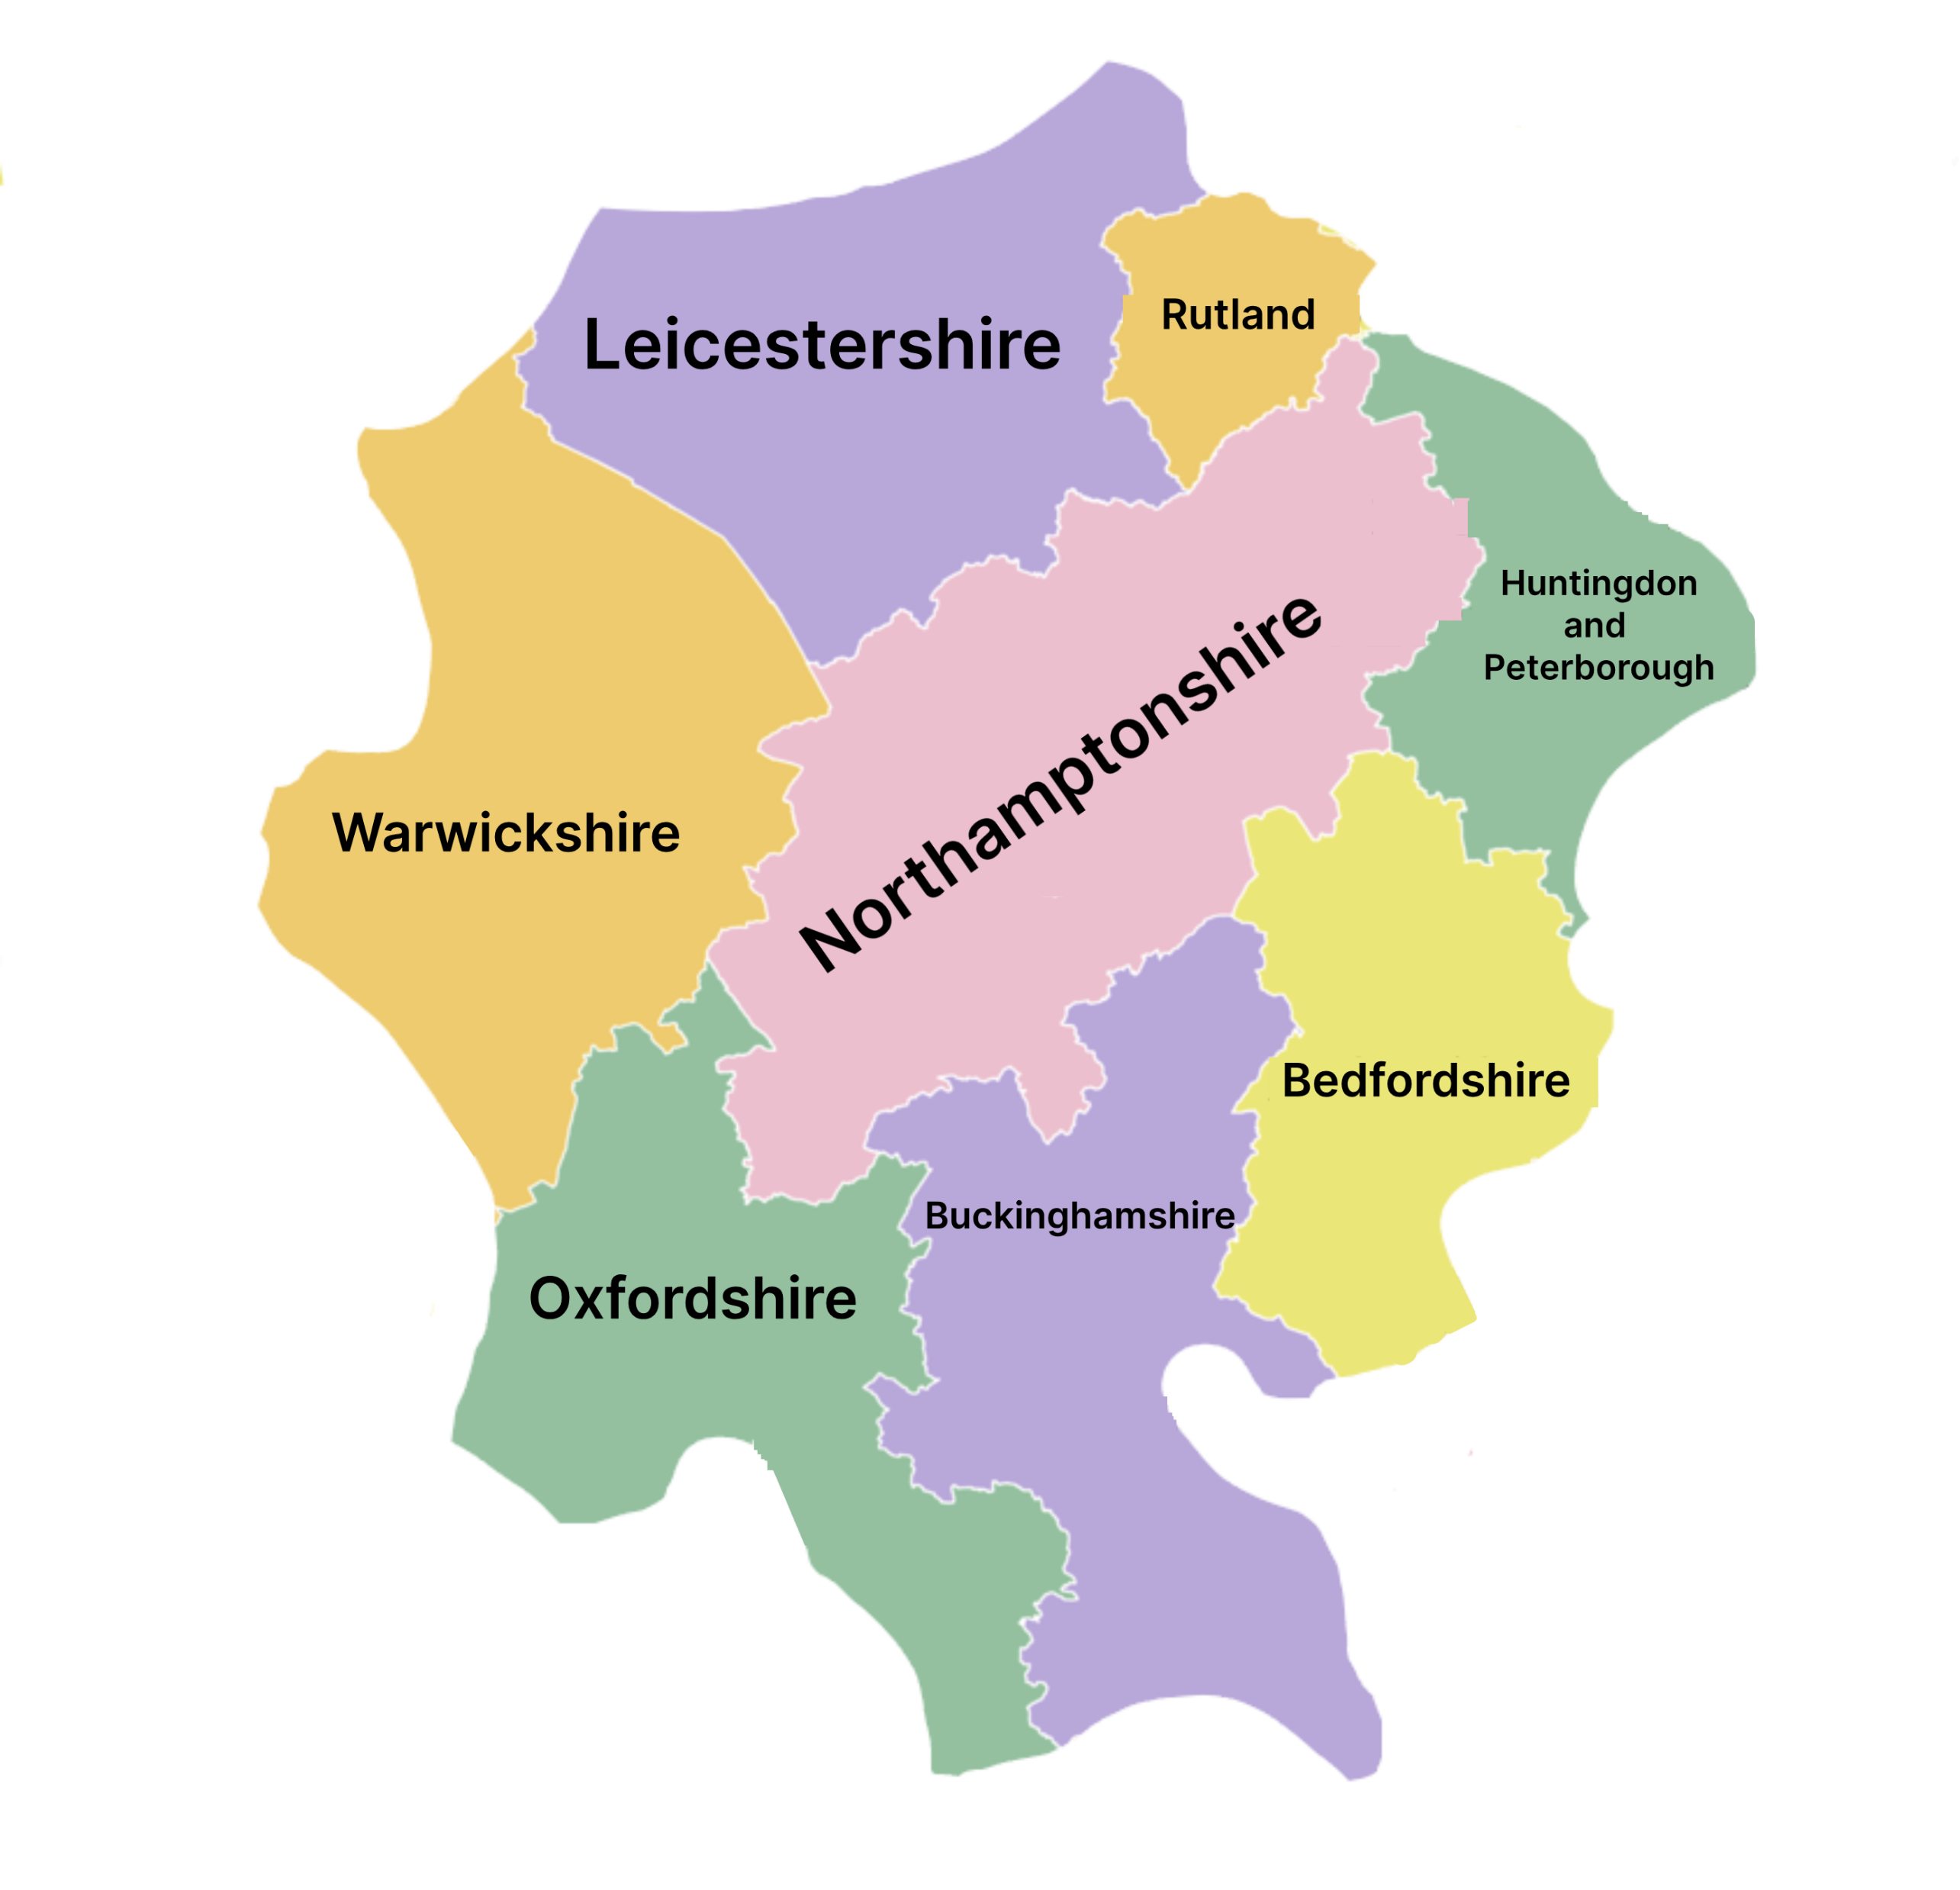
Where is the South Midlands?

Slide 12
Our goals
Our goal is to get as many local councils and stakeholders involved in Transport for South Midlands, with a goal to improve our long term public transport strategy goals, and do this in an environmentally sustainable way.
We also strive to create new ideas, with help from every one of our members. Any of our members can chip in ideas, as well as comment on existing ones at our meetings, which we’ll get more into later.
Another one of our goals is to get as many local councils and stakeholders involved as possible to make lobbying the Government and campaigning for new projects easier, with a larger voice.

Slide 13
Benefits of joining us
Having a louder voice: By joining us, you can have a louder voice in local transport issues, and bring ideas to the table for all of us to consider, as well as commenting on ideas already existing, and ones suggested by other members.
Give your input: Also, you can give your input on a very local level, by asking your residents for proposals and ideas to redirect to us in our meetings.
Collaborate with others: At our meetings, you’ll be able to communicate with other parish/town councils, and possibly in future, people with more authority, such as County Councils and Unitary Authorities, and even at some point, maybe Central Government Departments.

Slide 14
Our meetings
Every 3 months, we will hold a meeting with all members, to discuss ideas, and for members to have their say in existing ideas and campaigns.
Sometimes, meetings will have a specific agenda we will need to follow, however, most of the time, the meetings will be open.
Sometimes, our meetings will be joined by special guests from other non-member organizations.
Any member can suggest a meeting to be held at an earlier date, or another meeting entirely, with everyone, or specific members, or just one-to-one with Transport for South Midlands themselves.
One representee from each member council/organization can attend these meetings, preferably a member of the council/organization that has extensive transport knowledge.

Slide 15
When a concept is proposed
When one of our members proposes a campaign, the following will happen:
Other members will submit their kick-off comments on the proposal
The proposal will undergo an economic analysis. This analysis will be performed by one of the following
A member of TfSM that offered to complete the Economic analysis for us
A sub-national transport body
A transport consultancy firm, preferably local, but may have to be paid. The member that proposed the concept will pay for this economic analysis, but if they aren’t comfortable to, that’s no problem, we will resort to a different means of completing the analysis.
If the analysis comes back positive, the campaign will be transferred to Sustainable Transport Holdings
STH will choose one of their subsidiaries to manage the project’s admin.
A website will be created, and if not already made, a route on Google Earth if it’s a rail related project.
The member who suggested the idea will approve the above and allow the project to go live
Comments will be requested by other members of TfSM to then publish to the project's website.
Supporting members will support the campaigning of the project by helping us lobby the Government and other local councils which aren’t members.

Slide 16
When a concept is proposed
At every meeting, Sustainable Transport Holdings will give an update on the projects progress, as well as the original member project proposer, and Transport for South Midlands.
After the project update, members, supporting and unsupporting, will be asked their opinions and to make formal comments.
If the project is approved/denied, the meeting updates for that campaign will cease, unless a member asks to make a comment on the former campaign.

